Slide 2
Arrhenius Concept of Acids and Bases
An Arrhenius acid is a substance that, when dissolved in water, increases the concentration of hydronium ion, H₃O⁺(aq).
An Arrhenius base is a substance that, when dissolved in water, increases the concentration of hydroxide ion, OH⁻(aq).

Slide 3
The Arrhenius concept limits bases to compounds that contain a hydroxide ion.
The Brønsted–Lowry concept expands the compounds that can be considered acids and bases.

Slide 4
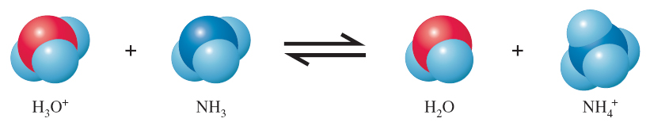
Brønsted–Lowry Concept of Acids and Bases
An acid–base reaction is considered a proton (H⁺) transfer reaction.
H⁺
H⁺
H⁺
H⁺

Slide 5
A Brønsted–Lowry acid is the species donating a proton in a proton-transfer reaction; it is a proton donor.
A Brønsted–Lowry base is the species accepting a proton in a proton-transfer reaction; it is a proton acceptor.

Slide 6
Substances in the acid–base reaction that differ by the gain or loss of a proton, H⁺, are called a conjugate acid–base pair. The acid is called the conjugate acid; the base is called a conjugate base.
Acid
Base
Conjugate base
Conjugate acid

Slide 7
What is the conjugate acid of H₂O?
What is the conjugate base of H₂O?
The conjugate acid of H₂O has gained a proton.
It is H₃O⁺.
The conjugate base of H₂O has lost a proton.
It is OH⁻.
Self-Ionization of Water
H₂O(l) + H₂O(l) H₃O⁺(aq) + OH⁻(aq)
Conjugate acid
Conjugate base
Base
Acid

Slide 8
Label each species as an acid or base. Identify the conjugate acid-base pairs.
a. HCO₃⁻(aq) + HF(aq) H₂CO₃(aq) + F⁻(aq)
Base
Acid
Conjugate acid
Conjugate base
b. HCO₃⁻(aq) + OH⁻(aq) CO₃²⁻(aq) + H₂O(l)
Acid
Base
Conjugate base
Conjugate acid

Slide 9
Self-Ionization of Water
H₂O(l) + H₂O(l) H₃O⁺(aq) + OH⁻(aq)
Base
Acid
Conjugate acid
Conjugate base

Slide 10
Lewis Concept of Acids and Bases
A Lewis acid is a species that can form a covalent bond by accepting an electron pair from another species.
A Lewis base is a species that can form a covalent bond by donating an electron pair to another species.

Slide 11
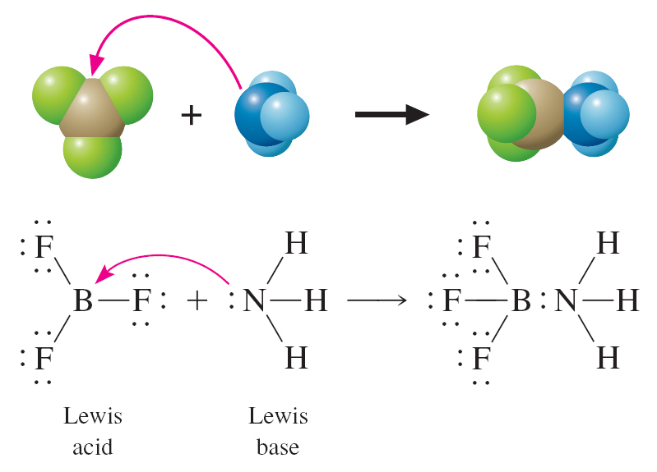

Slide 12
Relative Strengths of Acids and Bases
The stronger an acid, the weaker its conjugate base.
The weaker an acid, the stronger its conjugate base.

Slide 13
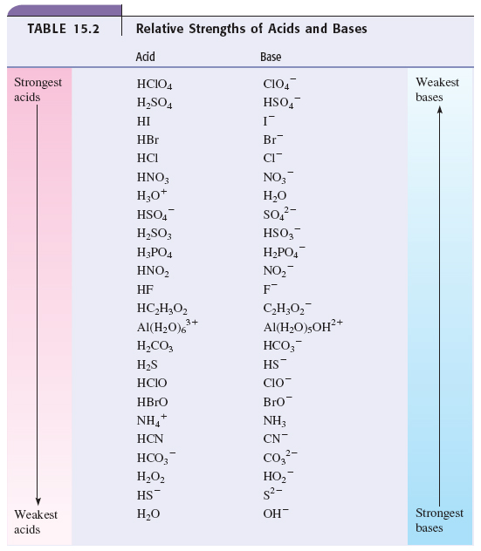

Slide 14
Decide which species are favored at the completion of the following reaction:
HCN(aq) + HSO₃⁻(aq) CN⁻(aq) + H₂SO₃(aq)
We first identify the acid on each side of the reaction: HCN and H₂SO₃.
Next, we compare their acid strength: H₂SO₃ is stronger.
This reaction will go from right to left (←), and the reactants are favored.

Slide 15
A reaction will always go in the direction from stronger acid to weaker acid, and from stronger base to weaker base.

Slide 16
Molecular Structure and Acid Strength
The strength of an acid depends on how easily the proton, H⁺, is lost or removed. The more polarized the bond between H and the atom to which it is bonded, the more easily the H⁺ is lost or donated.
We will look now at factors that affect how easily the hydrogen can be lost and, therefore, acid strength.

Slide 17
For a binary acid, as the size of X in HX increases, going down a group, acid strength increases.
HI > HBr > HCl >>HF

Slide 18
For a binary acid, going across a period, as the electronegativity increases, acid strength increases.
HCl > H₂S

Slide 19
H₂O and H₂S
These are binary acids from the same group, so we compare the size of O and S. Because S is larger, H₂S is the stronger acid.
HCl and H₂S
These are binary acids from the same period, but different groups, so we compare the electronegativity of Cl and S. Because Cl is more electronegative, HCl is the stronger acid.

Slide 20
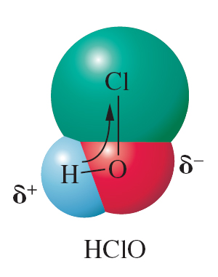
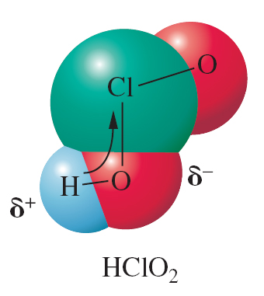
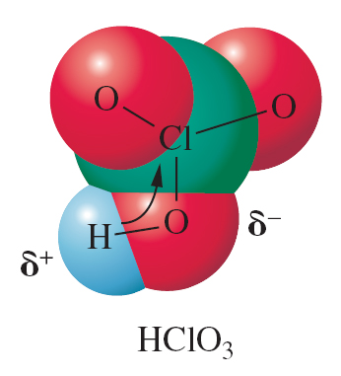
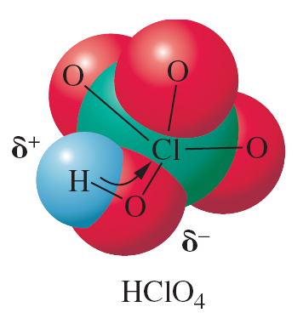
For oxoacids, several factors are relevant: the number and bonding of oxygens, the central element, and the charge on the species.
For a series of oxoacids, (OH)_{m}YO_{n}, acid strength increases as n increases.
(OH)ClO
n = 1
(OH)ClO₂
n = 2
(OH)ClO₃
n = 3
(OH)Cl
n = 0
Weakest
Strongest

Slide 21
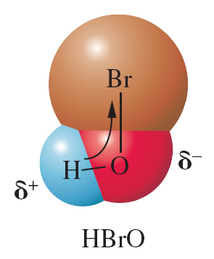
For a series of oxoacids differing only in the central atom Y, the acid strength increases with the electronegativity of Y.
Stronger
Weaker

Slide 22
The acid strength of a polyprotic acid and its anions decreases with increasing negative charge.
H₂CO₃ is a stronger acid than HCO₃⁻.
H₂SO₄ is a stronger acid than HSO₄⁻.
H₃PO₄ is a stronger acid than H₂PO₄⁻.
H₂PO₄⁻ is a stronger acid than HPO₄²⁻.

